Slide 1
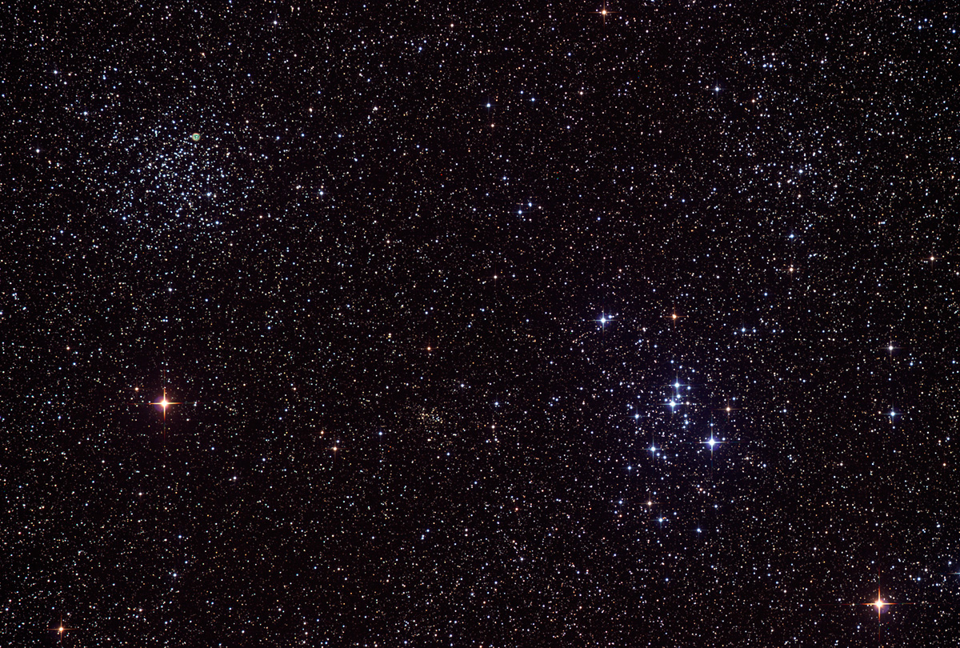

Howard
Astronomical
League
14
February 20th, 2014

Slide 2
Introductions

Slide 3
Upcoming club activities

Slide 4
Star Parties and public outreach!
Monday, March 3rd 7-9 PM:
Central Library
Saturday, March 8th, 6:30-9:30 pm: Scope out the Night, RNC
March 22nd: Public Star Party
March 29th: Members-only Star Party (Messier Marathon)

Slide 5
Member’s astrophotos and sketches

Slide 6
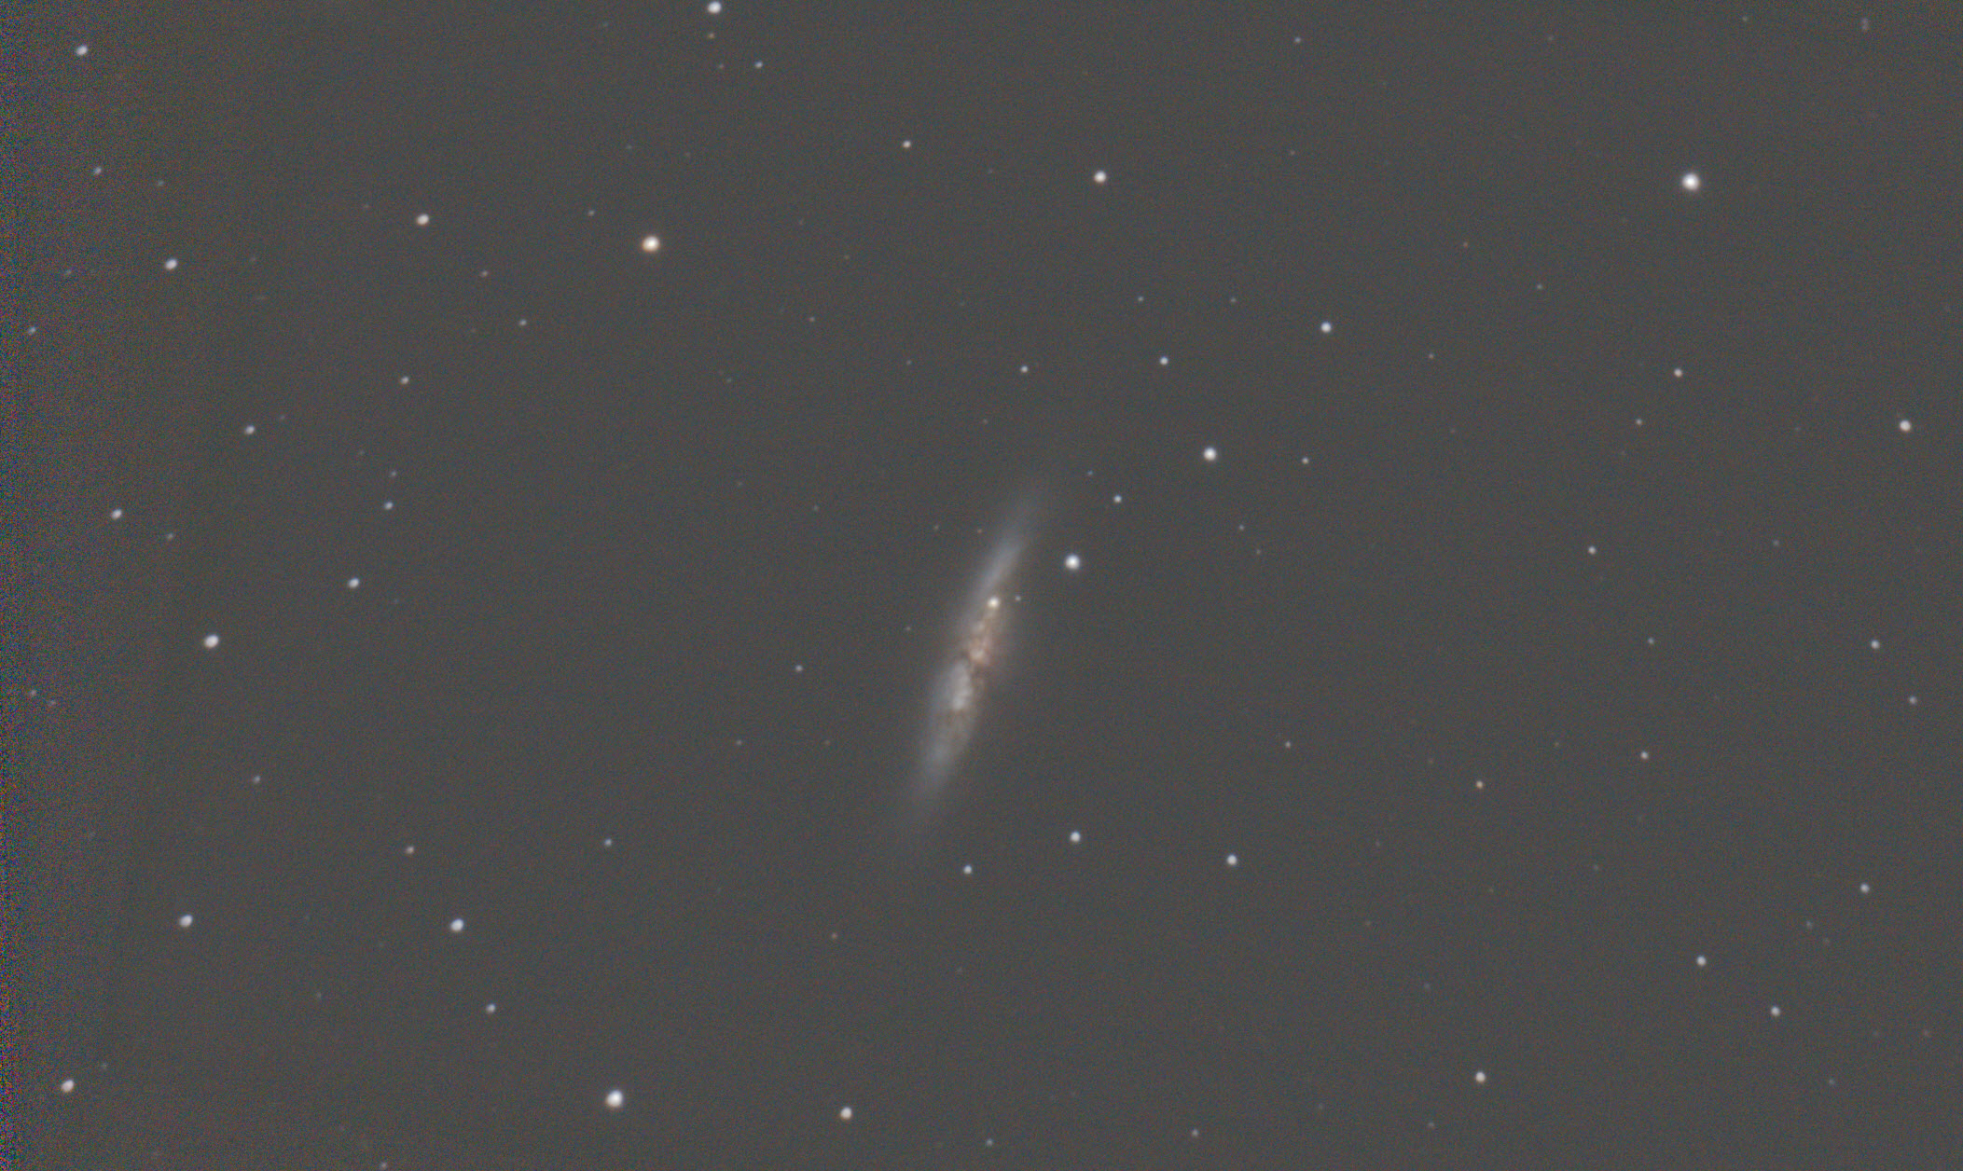
Mike Krauss

Slide 7
In the footsteps of William and Caroline
Rod Mollise

Slide 8
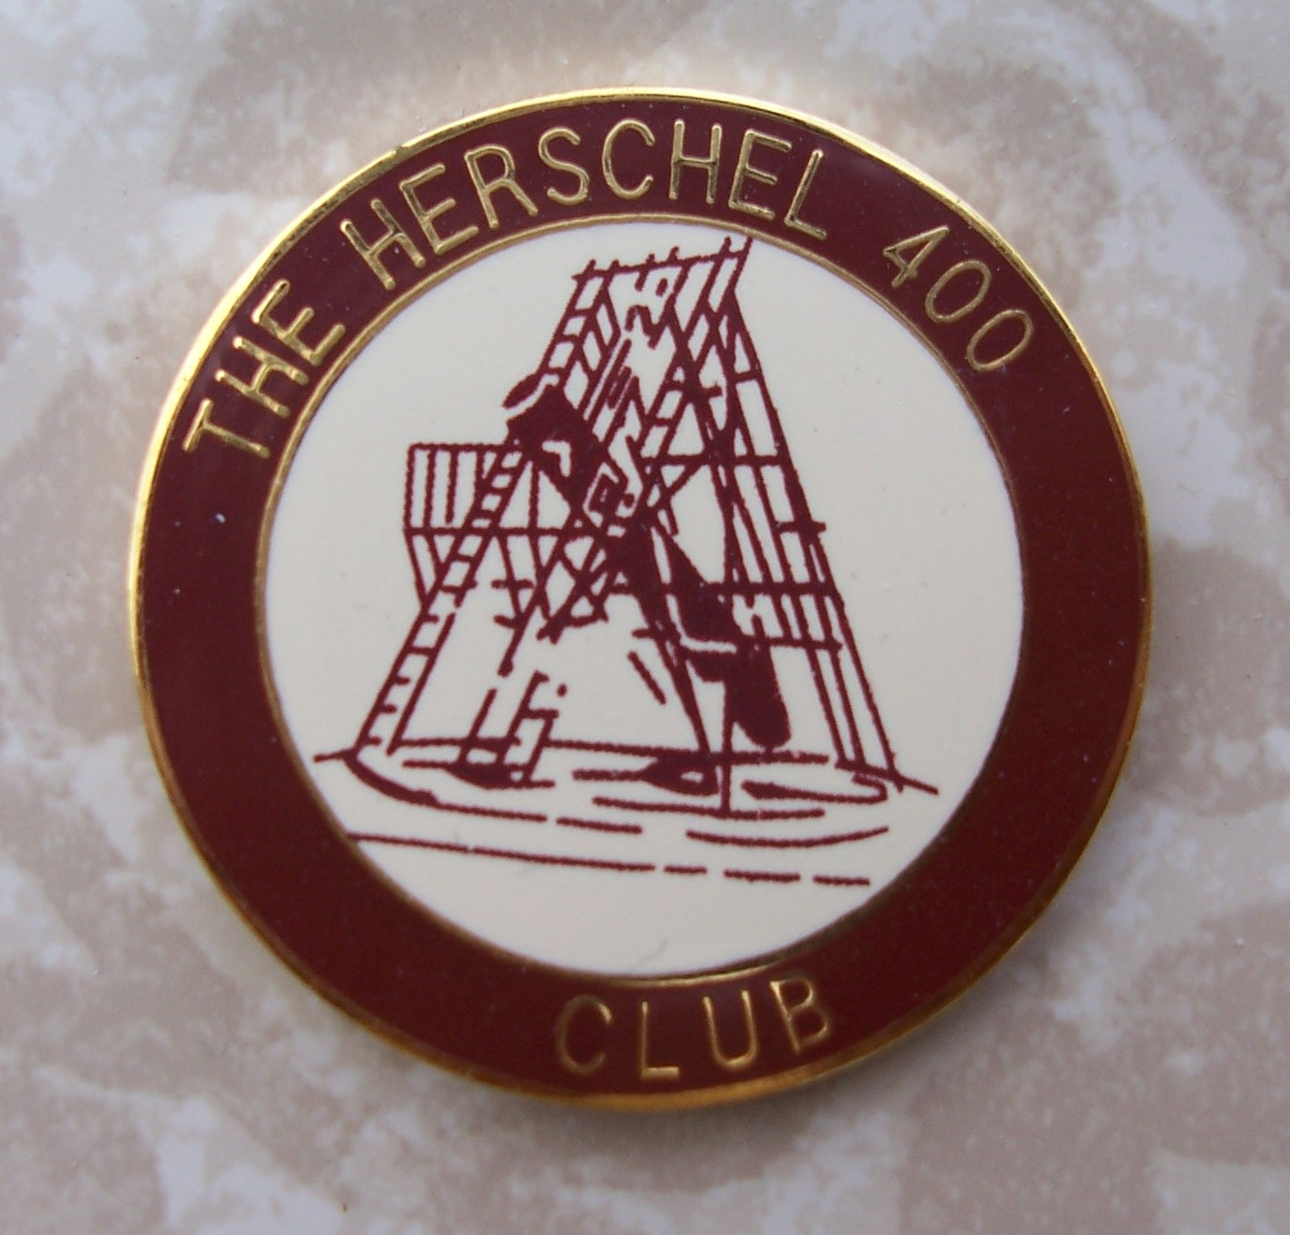
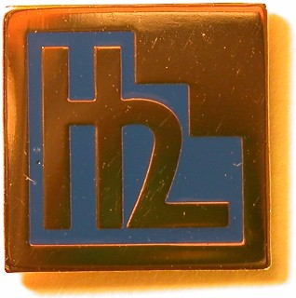
Herschel 400 and II Astronomical League observing programs

Slide 9
Herschel 400 and Herschel II
Observe all 400 objects
Log your observations
GOTO not explicitly disallowed
6” needed for 400, 8”+ for HII
Object type | Herschel 400 | Herschel II
Galaxies | 231 | 323
Open Clusters | 107 | 41
Globular Clusters | 33 | 3
Nebulae | 7 | 21
Planetary Nebulae | 20 | 9
Others | 2 | 3

Slide 10
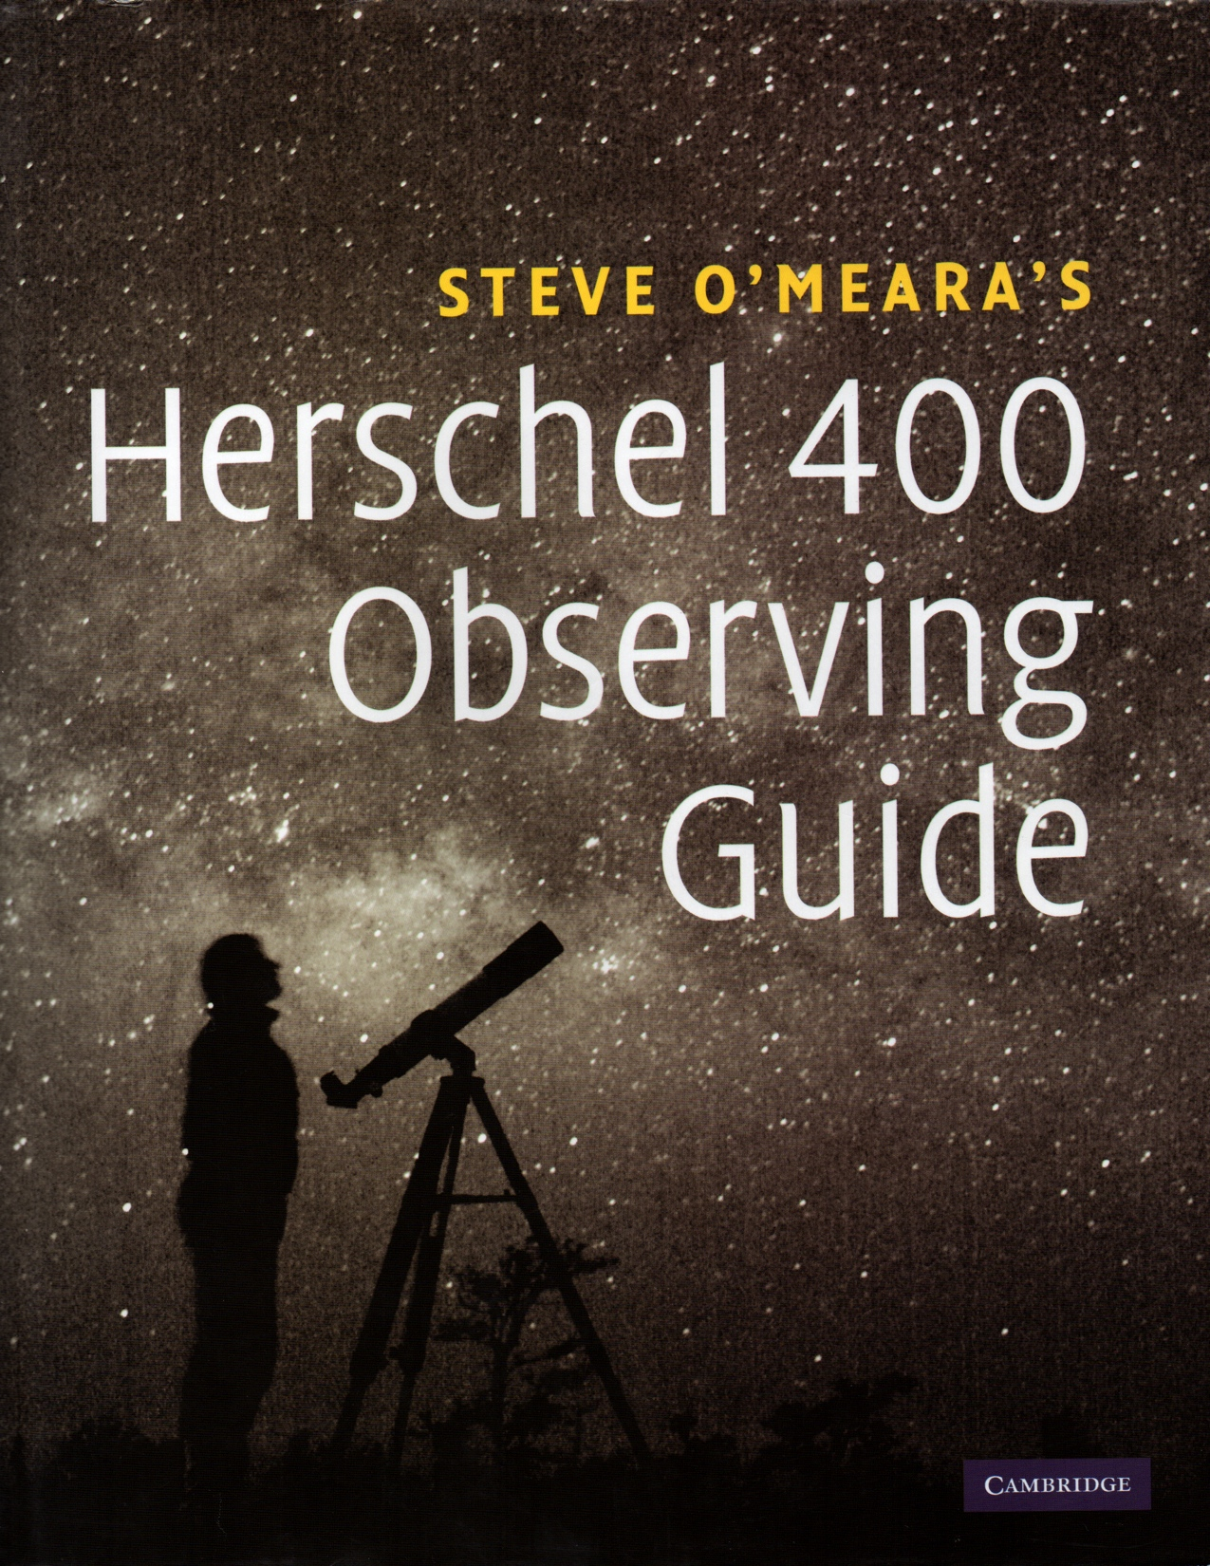

Slide 11
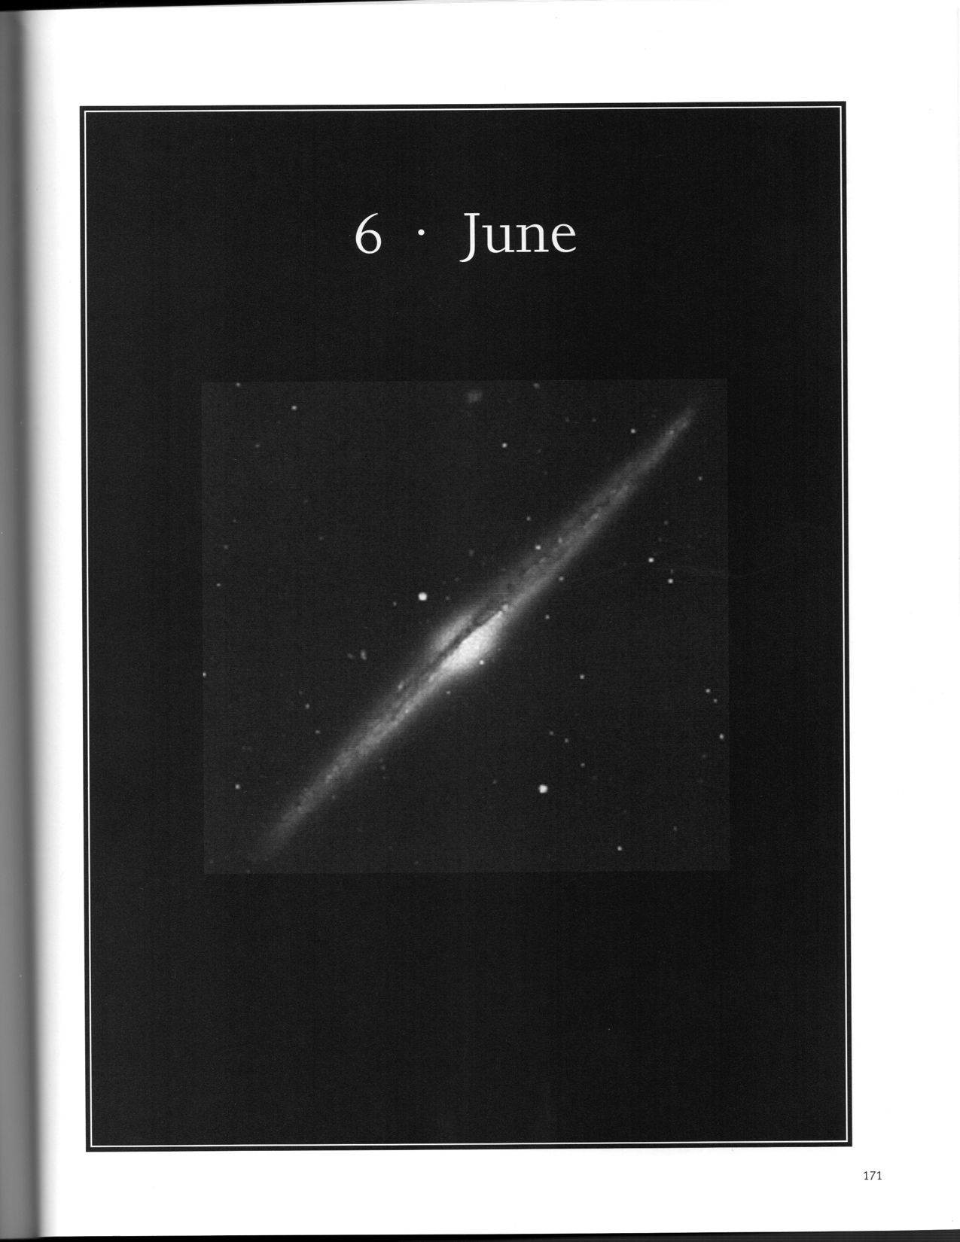

Slide 14
Thank You!
Next month’s meeting is on Thursday,
March 20th, 2014
7:30 PM
Astroschool at 7 PM: Star hopping and star charts/atlases
Meeting theme:
I don’t know yet

